Slide 1
Chapter 15
SPEARMAN’S RHO & MANN-WHITNEY U

Slide 2
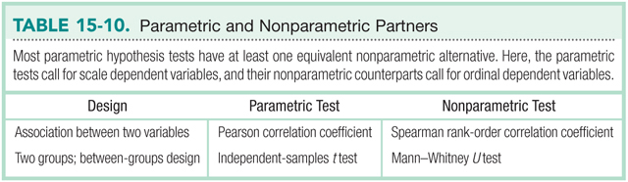

Slide 3
Spearman Rank-Order Correlation Coefficient
Spearman’s rho
Quantifies the association between 2 ordinal variables

Slide 4
Example
Every year in Wasdale, England, the World’s Biggest Liar Competition is held.
Are more creative people better able to tell lies?
Administered a creativity test to the top 10 finishers in the competition.

Slide 5
Example
Contest Position | Creativity Score | Creativity Rank
1 | 82 | 1
2 | 80 | 2
3 | 74 | 7
4 | 75 | 5.5
5 | 75 | 5.5
6 | 76 | 4
7 | 72 | 8.5
8 | 79 | 3
9 | 72 | 8.5
10 | 66 | 10

Slide 6
Example
Contest Position | Creativity Rank | Difference (D) | (D)²
1 | 1 | 0 | 0
2 | 2 | 0 | 0
3 | 7 | -4 | 16
4 | 5.5 | -1.5 | 2.25
5 | 5.5 | -0.5 | 0.25
6 | 4 | 2 | 4
7 | 8.5 | -1.5 | 2.25
8 | 3 | 5 | 25
9 | 8.5 | 0.5 | 0.25
10 | 10 | 0 | 0

Slide 7
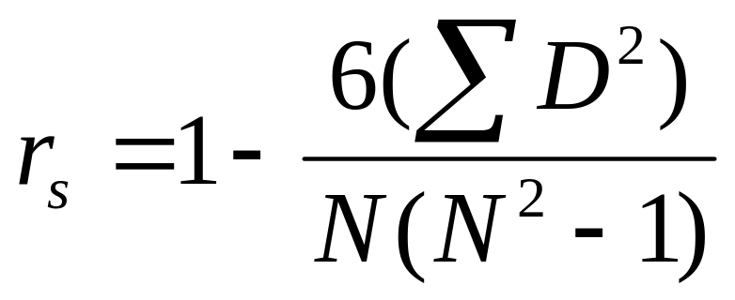
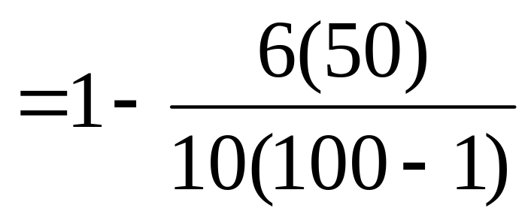
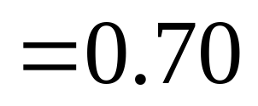
Calculating Spearman’s rho

Slide 8
Interpretation
Identical to interpretation of r
  Values range from -1 (perfect negative) to 1 (perfect positive)
  Sign tells direction of relationship
  Value indicates strength
As with r, rho doesn’t inform us about causation

Slide 9
Hypothesis Testing with rho
rho can be used as a descriptive statistic
Can also be used as an inferential statistic
  Test whether correlation is significantly different from no correlation (rho = 0)

Slide 10
H₀ & H₁
Null Hypothesis
  There is no relationship between creativity and finishing place in the World’s Biggest Liar Competition
Research Hypothesis
  There is a relationship between creativity and finishing place in the World’s Biggest Liar Competition.

Slide 11
Identify the Sampling Distribution
Sampling distribution is determined by N
N = 10
Critical value (α = .05) = .648

Slide 12
Make a Decision
Is calculated rho ≥ critical value?
  Yes
Reject H₀
There is a significant correlation between creativity and finishing place in the World’s Biggest Liar Competition. Participants with higher amounts of creativity place higher in the competition, rho(N=10)=0.70, p < .05.

Slide 13
Mann-Whitney U Test
Nonparametric equivalent of the independent-samples t test
Used when there are 2 independent groups and one ordinal DV

Slide 14
Example
Does intensive early training affect the performance of male singles tennis players?
Player | Rank | Training?
Y.O. | 1 | No
U.E. | 2 | No
X.P. | 3 | No
E.C. | 4 | Yes
T.E. | 5 | No
D.W. | 6 | Yes
O.R. | 7 | No
D.S. | 8 | Yes
H.E. | 9 | Yes
R.E. | 10 | No

Slide 15
Step 1: Assumptions
DV is ordinal
Participants were randomly selected
Ideally, no ranks are tied

Slide 16
Step 2: H₀ & H₁
Null Hypothesis
  There is no difference between players that have received intensive early training and those who haven’t.
Research Hypothesis
  Players that have received intensive early training are different from those who have not received the training.

Slide 17
Step 3: Identify the Sampling Distribution
Determined by sample size of Group 1 and sample size of Group 2
N_{A} = 4
N_{B} = 6

Slide 18
Step 4: Determine Critical Values
critical value = 2

Slide 19
Step 5: Calculate U
∑R_{yes} = 4+6+8+9 = 27
∑R_{no} = 1+2+3+5+7+10 = 28
Player | Rank | Training?
Y.O. | 1 | No
U.E. | 2 | No
X.P. | 3 | No
E.C. | 4 | Yes
T.E. | 5 | No
D.W. | 6 | Yes
O.R. | 7 | No
D.S. | 8 | Yes
H.E. | 9 | Yes
R.E. | 10 | No

Slide 20
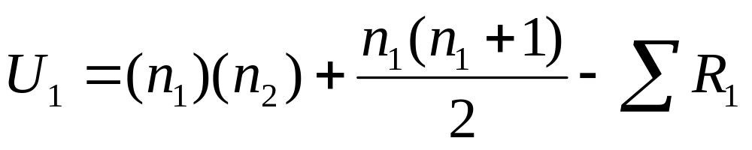
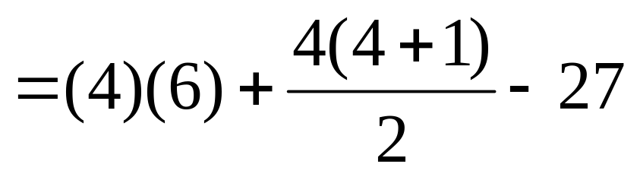
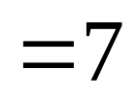
Step 5: Calculate U
Yes = 1
No = 2

Slide 21
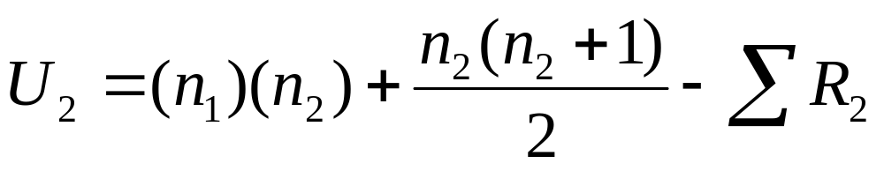
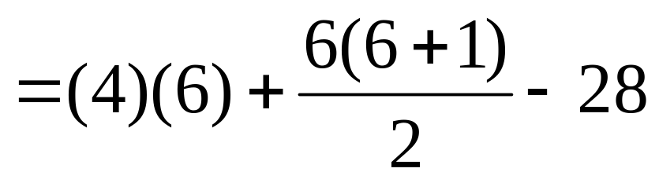
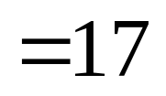
Step 5: Calculate U
Yes = 1
No = 2

Slide 22
Step 6: Make a Decision
Compare smaller test statistic to critical value
A small U value indicates a large difference between samples
Reject H₀ if calculated U ≤ critical U

Slide 23
Step 6: Make a Decision
Retain H₀
There is no evidence that the distribution of players trained early and intensively is significantly different from the distribution of those without such training, U = 7, p > .05.

